Slide 1
A 40-year old triathlete in remission from skin cancer complaining of shoulder pain
Holly & Tola

Slide 2
Introduction
We have found little information/research on the contraindications of treating a skin cancer remission patient for shoulder pain.
We have found that we would find out how long the patient has been in remission and advise them to go to their GP to check that the cancer has not returned or associated with the shoulder pain.
However, we believe that the cancer is not the cause of the shoulder pain and therefore will focus more on other factors when diagnosing the injury/pain.
An important factor as a practitioner to be aware of when diagnosing and treating this patient, is that they are in remission from skin cancer.
This is important as there are red flags that NICE – (national institute for health and care excellence) have guidelines on when treating cancer patients. These include as listed-
Unexplained weight loss, feeling unwell and fatigued. If the patient has any of the symptoms you must refer them to their G.P.
It would also be recommended to refer the patient to a G.P to get an x-ray to see if anything is blocking the joint.
rotator cuff injuries have been shown to be the third most common injury of the shoulder (Weiss et al,2018)
Remission is when cancer cannot be detected in the body and there are no symptoms. This may also be called having “no evidence of disease” . https://www.cancer.net/cancer-types/skin-cancer-non-melanoma/treatment-options
60% of swimming injuries are related to the shoulder, due to repetitive excessive over-rotation and constant overloading of the joint and muscles.- http://www.gophysiotherapy.co.uk/blog/common-triathlon-injuries/
swimmers use large arm movement forces to reach forward to drag the water.
This may contribute to shoulder injury and pain. (Sein et al,2010)
Notes:
The patient is a triathlete which typically consists of running, swimming and cycling.
From research, we have found that the most common injury in triathletes is due to swimming This is because the swimmer uses large movement arm forces to reach forward to drag the water which can result in pain and injury of the shoulder. (Etxebarria, Mujika & Pyne, 2019) Which is what the patient is essentially presenting.
The case study that has been given to us is very brief, as the only information given on the injury itself is that the patient has ‘shoulder pain’. (Raney et al, 2017) explains that. Pain is a multifactorial experience that incorporates various facets of sensation.
Due to this we have researched the symptoms of different shoulder pathologies and tried to link them to the patient being a triathlete and middle aged. Which will be key factors in the diagnosis.
We have also taken into account that the patient is in remission from skin cancer.
Again, we have not been given exact details of where the cancer was on the patient’s body or what type of skin cancer. There are many different skin cancers that the patient could have had which we have included in our PowerPoint. we have got this information from the official NHS website and believe it to be a reliable source.
Before diagnosing the patient, we would check for symptoms that the skin cancer has returned. This would be checking for any moles that may be unusual or new. According to the NHS ‘Normal moles are generally round or oval, with a smooth edge, and usually no bigger than 6mm (1/4 inch) in diameter.’ It would be especially important to check around the shoulder area due to potential treatments carried out due to the patients shoulder pain such as massage.
We have found little information/research on the contraindications of treating a skin cancer remission patient for shoulder pain.
We have found that we would find out how long the patient has been in remission and advise them to go to their GP to check that the cancer has not returned or associated with the shoulder pain.
However, we believe that the cancer is not the cause of the shoulder pain and therefore will focus more on other factors when diagnosing the injury/pain.

Slide 3
Different types of skin cancer
Information from-
https://www.nhs.uk/conditions/melanoma-skin-cancer/
Superficial Spreading melanoma
Exposure to ultraviolet (UV) light from the sun is thought to cause most melanomas, but there's evidence to suggest that some may result from sunbed exposure.
.
Certain things can increase your chances of developing melanoma, such as having:
lots of moles or freckles
pale skin that burns easily
red or blonde hair
a close family member who's had melanoma
Lentigo maligna melanoma
Nodular melanoma
Amelanotic melanoma
Acral lentiginous melanoma
Notes:
An important factor as a practitioner to be aware of when diagnosing and treating this patient, is that they are in remission from skin cancer.
This is important as there are red flags that NICE – (national institute for health and care excellence) have guidelines on when treating cancer patients. These include as listed-
Unexplained weight loss, feeling unwell and fatigued. If the patient has any of the symptoms you must refer them to their G.P.
It would also be recommended to refer the patient to a G.P to get an x-ray to see if anything is blocking the joint.

Slide 4
Contraindications and red flags due to skin cancer
Skin cancer, especially the type that has spread, can cause arthritis-like discomfort in the body. "Some skin cancers can involve nerves under the skin and can present as discomfort or pain," says Papantoniou. https://www.bustle.com/p/7-skin-cancer-symptoms-you-cant-see-that-you-should-know-about-2301296
Red flags:
Unexplained weight loss
Feeling unwell
Fatigued
If any of the above refer to GP
(NICE GUIDELINES )
Skin cancer Carcinoma
No massage due to the risk of an unwanted cellular response also other treatments e.g exercise
Treatment:
Removal- surgery, cryotherapy, photo dynamic therapy
-radation
-chemotharapy
-immunotherapy

Slide 5
Pathology of skin cancer
Signs:
-unusual looking spot
Rapidly evolves and causes skin elevation
- Borders irregular
-asymmetrical shape
Melonoma is cancer of the skin
Melonoma is the highest rate of cancer
Risk factors:
Family history
Personal history
Immunosupression
Light eyes and hair colour
High freckle density
Tanning bed exposure
Treatment:
Removal- surgery, cryotherapy, photo dynamic therapy
-radation
-chemotharapy
-immunotherapy
Notes:
After clearing any red flags, it would be safe to carry out a clinical assessment.
This would include a postural and gait assessment. Clearing the joints above and below the shoulder, which would be the cervical spine and elbow, palpating and checking for any swelling/bruising/red marks around the area. Testing range of movement using active, passive and resisted tests on the non-injured shoulder and then comparing to the injured shoulder. By carrying out this assessment you would be able to see if the patient has pain or a true block, which is very useful for finding a diagnostic.

Slide 6
TRIATHLETES
It has been argued that triathlon as a multi sport event, causes less overuse injuries than single sports because of the more even distribution of loads over the body's musculoskeletal structures, despite this they still suffer from a high degree of overuse injuries. (Manninen& Kallinen,1996).
Notes:
Suggestions from research we have found about swimmers that swimmer's shoulder represents a part of the impingement syndrome complex, rotator cuff tendonitis, biceps tendonitis, and shoulder instability.1 – (Tovin, 2006)
From our research we have narrowed the possible shoulder pathology’s down to the following-
Shoulder tendinopathy
Shoulder instability
Rotator cuff tear
Biceps Tendonitis
Frozen shoulder

Slide 7
Differential diagnosis
Most Common
Frozen shoulder
internal impingement
Rotator cuff tendinopathy
Less Common
External impingement
Bicep Tendonitis
Rotator cuff tear
Shoulder instability
Not to be missed
Tumor
Gall bladder
Perforated duodenal ulcer
Spleen
Apex of lungs

Slide 8
Shoulder pathologies we are discussing
Shoulder tendinopathy
Shoulder instability
Rotator cuff tear
Frozen shoulder
Bicep Tendonitis

Slide 9
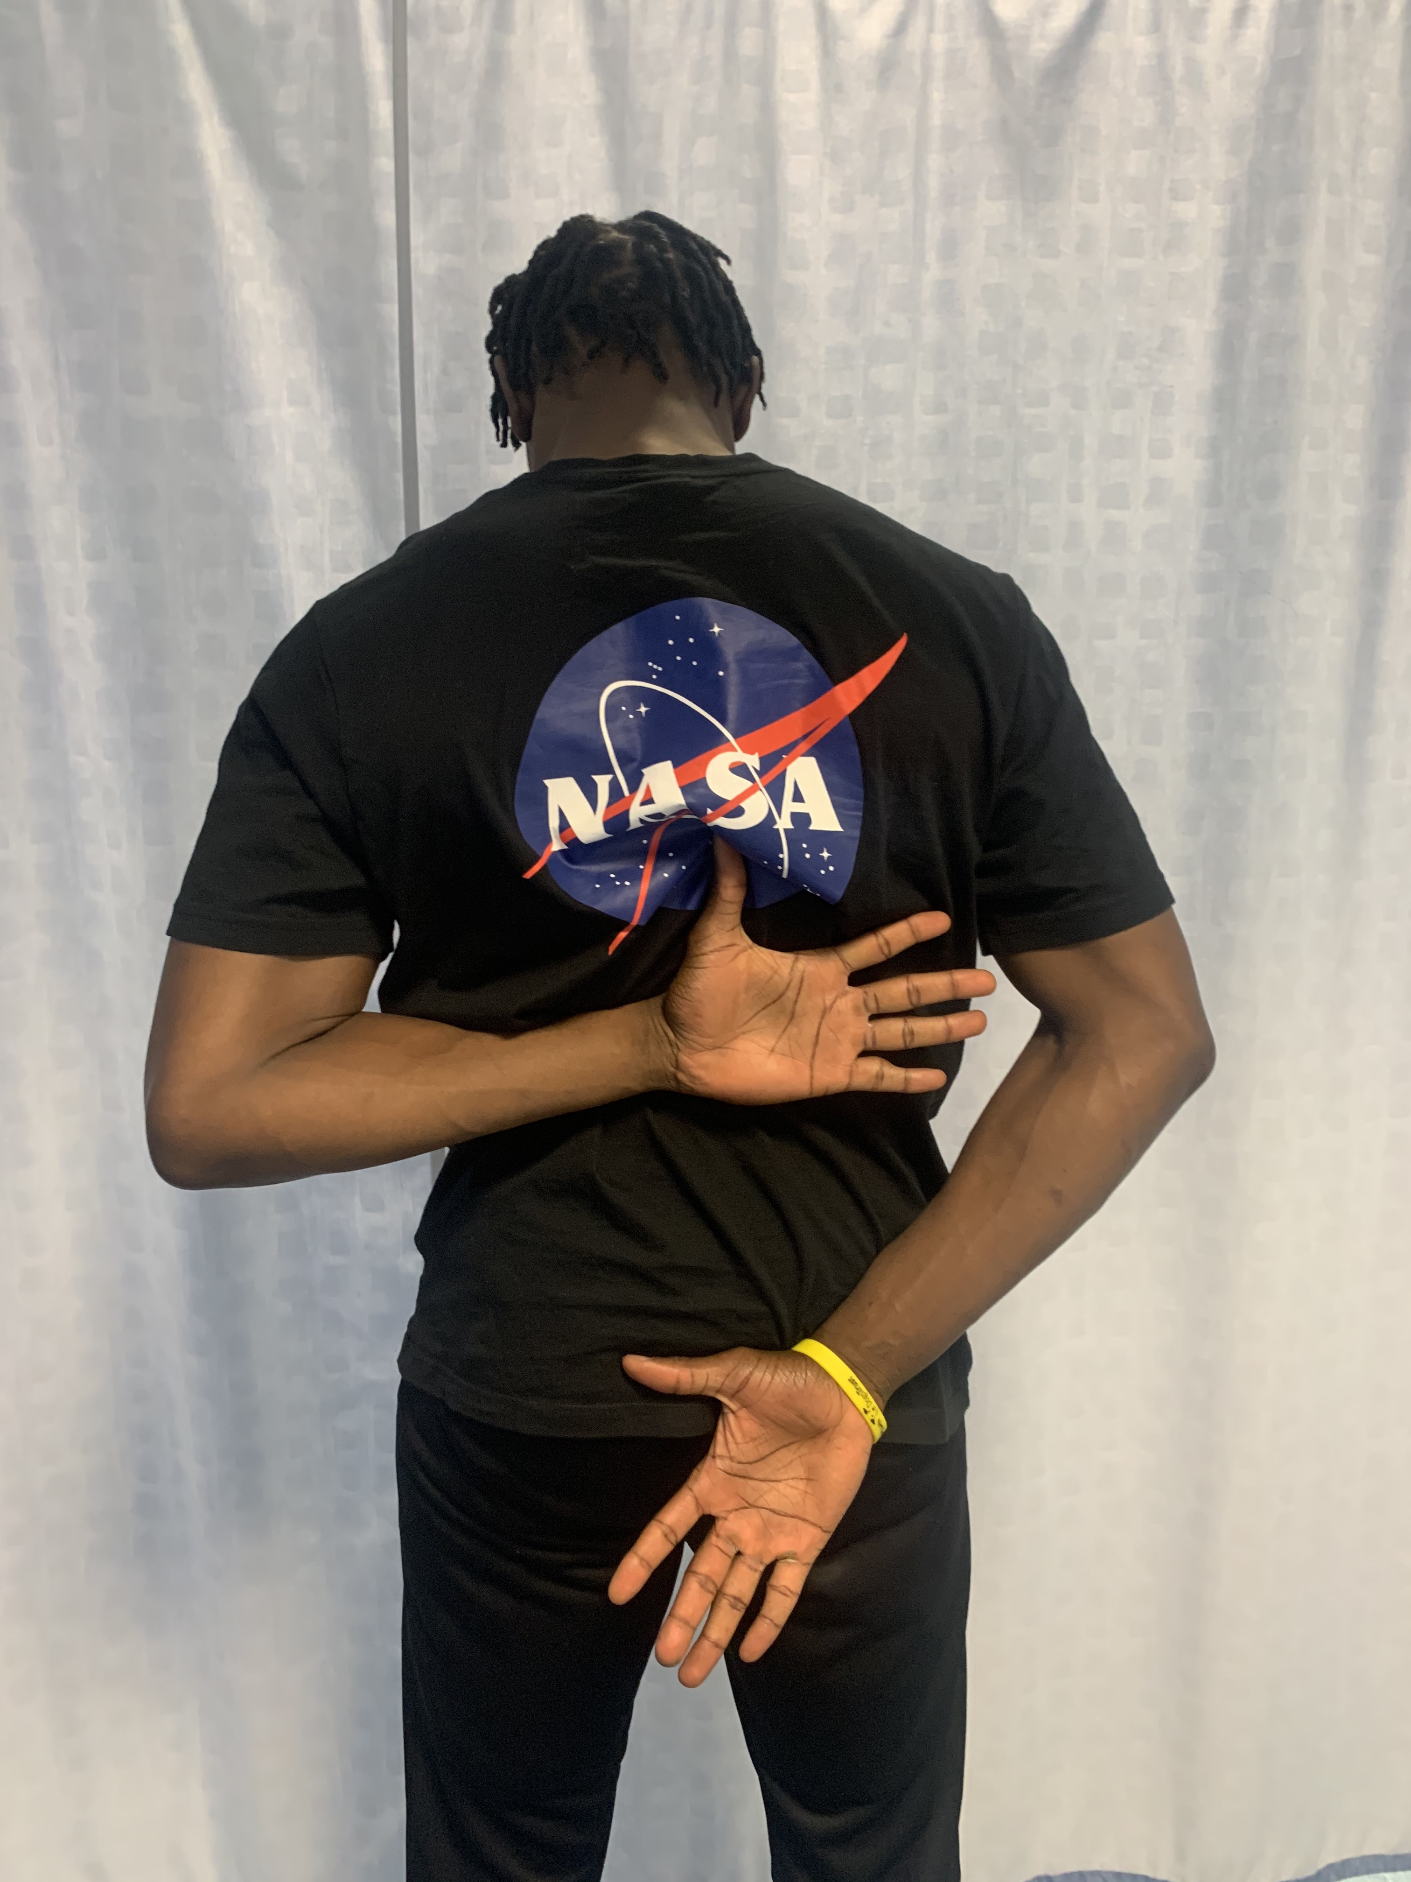
Frozen shoulder
Information from https://www.physio-pedia.com/Adhesive_Capsulitis
Risk Factors
Diabetes mellitus (with a prevalence up to 20%)
Stroke
Thyroid disorder
Shoulder injury
Dupuytren disease
Parkinson disease
Cancer
Complex regional pain syndrome^{[10]}
Specail Tests
Shoulder flexion + abduction + ER
Hand to scapula
Shoulder extension + adduction + IR
Hand to opposite scapula
Shoulder flexion + horizontal adduction
Tens Machine
Notes:
Frozen shoulder also known as Adhesive Capsulitis is a common condition, which has been described as a painful condition related to quality of sleep, as the pain and stiffness affects their ability to be comfortable. Onset before the age of 40 is very uncommon. (Dias,Cutts & Massoud, 2005).
The pain comes on slowly and is felt at the insertion of the deltoid. There is restriction in active and passive movement, restricted elevation and external rotation. The patient complains of excruciating pain throughout the joint nevertheless is still able to main normal life routines (Hand,et al, 2007)
Frozen shoulder is most common in patients between 40 and 65 years old. (Kelley, McClure & Leggin 2009). There are some everyday tasks that you can get the patient to replicate to determine if they may test positive for frozen shoulder. This includes everyday tasks such combing hair, putting on a necklace, fitting a bra, putting on a jacket and getting into your back pocket.
In the presentation we have provided pictures in our PowerPoint of these actions.
The treatment for frozen shoulder would be very gentle shoulder mobilisations. kinesiology tape can help for pain relief, especially through the inflammation phase. Another method of treatment could be the TENS machine which has been shown to reduce pain and increase range of motion. (Physiopedia contributors 2019).

Slide 11
Biceps Tendonitis
https://www.physio-pedia.com/Biceps_Tendinopathy
What are the symptoms of biceps tendinitis?
Pain in the front of the shoulder and down to the biceps muscle
Pain that is often worse with lifting the arm in front of the body or above the shoulder
Snapping of the biceps tendon with shoulder motion
Pain that interferes with daily life, recreation or job activities
Pain that prevents or disrupts sleep
https://www.upmc.com/services/sports-medicine/conditions/bicep-tendonitis
Notes:
The Ohio State University Wexner Medical Centre 2019 Explains that
Diagnosing bicep injuries is a physician gathering a medical history and performing a physical examination of the shoulder. There may be tenderness over the biceps during the exam, or pain with certain exam movements. However, an X-Ray and imaging (MRI) is what can confirm the diagnosis and also identify other associated injuries such as rotator cuff tears.
Biceps tendinopathy is a common injury that mainly presents as pain, tenderness, and weakness in the tendon of the long head of the biceps brachii.
Tendinopathy is an overuse injury and often presents in the affected tendon as pain with activity as well as sensitivity to palpation. the pain and degeneration of tissue lead to decreased ability to tolerate tension on the tendon, so therefore decreases functional strength (Rainey,et al, 2017)
The Physiopedia website explains that to identify positive for potential bicep tendinopathy it is essential to carry out the Hawkins test: which is the patient flexing their elbow to 90 degrees while the physician elevates the patient's shoulder to 90 degrees and places the forearm in a neutral position. With the arm supported, the humerus is rotated internally. The test is positive if bicipital groove pain is present.
Strength testing of shoulder, elbow and wrist should all be completed to ensure no significant weakness of other structures. There may also be associated rotator cuff weakness due to the high prevalence of shoulder injuries accompanying biceps tendinopathy.
UPMC sport medicine 2019 explains that swimming increases bicep tendonitis. Sever overuse of the bicep tendon can cause a tear which requires surgery to repair. However, to treat a mild bicep tendonitis.
A break from the sport or activity that caused the problem
Nonsteroidal anti-inflammatory drugs (NSAIDs)
Physical therapy and exercises
Cortisone injections
Platelet rich plasma

Slide 12
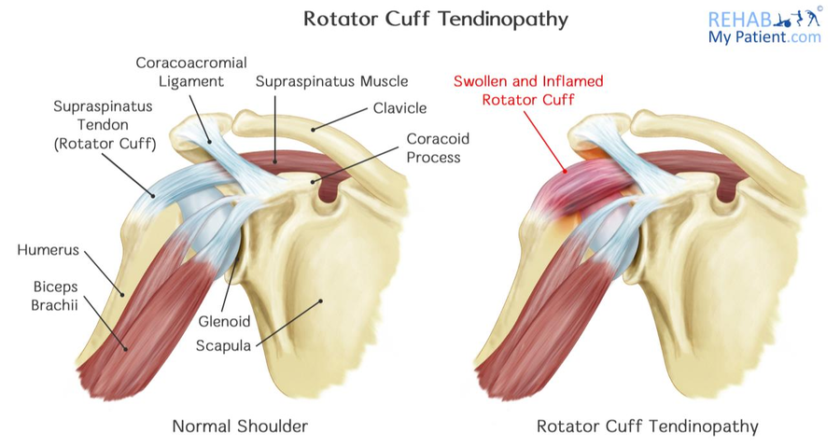
Rotator cuff Tendinopathy
Rotator cuff tendinopathy frequently refers to pain and instability with relation to and a consequence of overuse or the rotator cuff muscles
Subjective assessment
Night pain
May have had a x-ray showing calcium deposits
Dull ache around the shoulder
Objective assessment
Pain in abduction above 70°
Decrease in strength at the Rotator cuff muscles
Decrease in internal rotation
Pain with resisted abduction
Tenderness near the insertion point of the supraspinatus tendon
Special test
Empty can test
Hawkin’s Test
Belly press test
Notes:
Rotator cuff tendinopathy frequently refers to pain and instability with a relation to and a consequence of overuse or the rotator cuff muscles. pain is often associated with external rotation, abduction and elevation of the shoulder. The rotator cuff is made up of four different muscles supraspinatus, infraspinatus, teres minor and subscapularis. The supraspinatus is the major muscle in this group and is in control of keeping the head of Humeral in place. The supraspinatus tendon takes on a large amount of pressure when there are constant overhead movements. For example, swimmers and basketball players are both susceptible to this due to them having to perform constant overhead movements. Rotator cuff tendinopathy causes pain when the glenoid humoral joint is in abduction over 70° as well as when the joint is internal and external rotated. age is also a big causer of Rotator cuff tendinopathy as an over 40 that swims regularly the prolonged use of the tendon can be a cause of the pain and the reason why the tendinopathy occurred.

Slide 13
Shoulder Instability
Notes:
As swimmers participate in repetitive overhead movements; it is likely that swimmer’s shoulder may involve glenohumeral joint laxity. and the “instability complex" described by Jobe et al.21
hypothesized that repetitive and forceful overhead activity causes a gradual stretching out of the anteroinferior capsuloligamentous structures leading to mild laxity, instability, and impingement. The following diagram in our presentation summarizes their hypothesis.
Shoulder instability is a problem that occurs when the structures that surround the shoulder joint do not work to maintain the ball within its socket. If the joint is too loose, it may slide partially out of place, a condition called subluxation which is partial dislocation of the shoulder joint. Patients with this condition will complain exclusively of pain in the affected area or of a ‘dead arm’ To identify the anterior instability and to rule out multidirectional instability the patient needs clinical examination. This includes the apprehension test, The anterior drawer test of the shoulder, the posterior drawer test and inferior instability test. It had been found from many authorities that exact diagnosis of multidirectional instability is critical as different therapies are required for these different conditions. (Gerber,Ganz,Reinhold, 1984)

Slide 14
Instability complex" described by Jobe 4,21,27 Jobe et al.21
Jobe et al, hypothesized that-
repetitive and forceful overhead activity causes a gradual stretching out of the anteroinferior capsuloligamentous structures leading to mild laxity, instability, and impingement. The following diagram summarizes their hypothesis.
(Sein, et al, 2010)
Repetitive Forceful stress
Chronic
Microtrauma
Mild Anterior Instability
Mechanical Impingement
Laxity

Slide 15
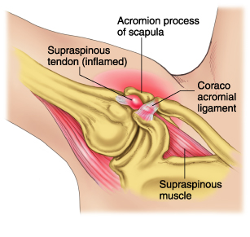
Internal impingement
Internal impingement also known as swimmers shoulder and rotator cuff tendinitis is frequently refer to as a condition linked to overuse and excessive contact of the humeral head and the glenoid border. This occurs when the arm Is constantly positioned in extreme ranges of external rotation and abduction.
Objective assessment
Posterior shoulder pain
Anterior shoulder pain
Pain during abduction
Pain during external rotation
Treatment
Rotator cuff activation
Stabilisation exercises
Mobilisations for the deltoid
Notes:
Internal impingement which is also known as swimmers’ shoulder is frequently refer to as a condition linked to overuse and excessive contact of the humeral head and the glenoid border. This occurs when the arm Is constantly positioned in extreme ranges of external rotation and abduction. It can also be caused by continued trauma to the joint leading to laxity within the joint. This is a condition constantly linked to athletes that take part in overhead sports. For example, basketball players, tennis players and swimmers. Internal impingement is suggested to be the most common reason of chronic shoulder pain in overhead athletes. (Cools, A. M et al 2018).

Slide 16
Stretching
Mobilizations
Strength & Endurance
Proprioception& functional training
Return to sport
dorsal-glide mobilisations can be performed. The patient’s shoulder is placed in the end range of internal rotation and the therapist performs manual translational glides in the dorsal direction. Research indicates that particularly high-grade end- range mobilisations result in a permanent increase in ROM, greater than that achieved with low-grade mid-range mobilisa- tion techniques.
Falkel et al suggest that midseason management of a swimmer can be accomplished by decreasing yardage by half of the normal amount. swimming for a set time period instead of a set distance
stretching can be performed by stabilizing the scapula on the thorax while crossing the arm over the chest. This stretch can be done at 90" of shoulder flexion and above and below 90" of shoulder flexion in order to get all portions of the cuff. Mobilisation of the posterior capsule can be performed with the shoulder in 90" of flexion with the elbow flexed. Pressure should be directed in an anterior to posterior fashion
The strengthening pro gram should correct the imbalances that exist between
the anterior and posterior shoulder muscles. A strengthening program for swimmers should have three primary con- siderations:
isolation of the rotator cuff muscles
muscular endurance
sports-specific function
By having the athlete concen- trate on both humeral and scapular position during strengthening exercises and swimming, conscious proprioception may be enhanced.
CONCLUSION
TREATMENT FOR INTERNAL IMPINGEMENT
Notes:
Overall the generic treatment recommended to this patient would be that if they are experiencing shoulder pain while sleep, sleeping on the injured shoulder or with the arm elevated overhead will often increase the pain. Therefore, the most comfortable position is usually lying supine with the head and shoulder slightly elevated with pillows positioned on the posterior and lateral sides of the adducted shoulder and arm.
Ice can also be beneficial in the early stages of treatment. An article from (Bertoft,1999) recommends icing for 5-7 minutes until the shoulder becomes numb or cold packs for 20-30 minutes which can reduce inflammation and pain. Anti-inflammatory medications may also be beneficial for short durations.
An article from (Bales & Bales,2012) explains that the most common swimming technique used by triathletes is the freestyle stroke. During this the shoulder undergoes repetitive overhead movements. Because of the constant overhead motions, it can cause microtrauma from mechanical impingement, general laxity or both. Which without enough rest and recovery it may result in inflammation and pain to the shoulder.
From using differential diagnosis, the pathology we have decided to use in terms of management for this patient is internal impingement. The rehabilitation for swimmers with internal impingement includes improving range of motion, strength, mobilization and flexibility. As well as proprioception training. It has been widely recognized that strength deficits of the rotator cuff muscle have serious implications in impingement. (Allegrucci, Whitney & Irrgang, 1994)
A typical posture of a swimmer includes forward rounded shoulders and protracted scapulae. This static postural alignment may give rise to muscle imbalances with adaptive shortening. (Allegrucci, Whitney & Irrgang 1994).
Flexibility exercises and mobilisation techniques can help track progress, but It is important to increase mobility without producing greater instability.
We have found an article that has a rehab programme for treatment in swimmers with internal impingement. The article recommends improving stretching, mobilisations, strength, endurance, and proprioception training. We have included their recommendations for a swimmer’s rehab programme in out presentation.
For return to sport it is recommended to allow each swimmer to warm up at his own pace. Also, Increasing the rest intervals during and between training sessions could allow further recovery from fatigue. (Allegrucci,Whitney & Irrgang, 1994)

Slide 17
Conclusion
Overall the generic treatment recommended to this patient would be that if they are experiencing shoulder pain while sleep, sleeping on the injured shoulder or with the arm elevated overhead will often increase the pain. Therefore, the most comfortable position is usually lying supine with the head and shoulder slightly elevated with pillows positioned on the posterior and lateral sides of the adducted shoulder and arm.
Ice can also be beneficial in the early stages of treatment. An article from (Bertoft,1999) recommends icing for 5-7 minutes until the shoulder becomes numb or cold packs for 20-30 minutes which can reduce inflammation and pain. Anti-inflammatory medications may also be beneficial for short durations.
An article from (Bales & Bales,2012) explains that the most common swimming technique used by triathletes is the freestyle stroke. During this the shoulder undergoes repetitive overhead movements. Because of the constant overhead motions, it can cause microtrauma from mechanical impingement, general laxity or both. Which without enough rest and recovery it may result in inflammation and pain to the shoulder.

Slide 18
References
– Sein, M. L., Walton, J., Linklater, J., Appleyard, R., Kirkbride, B., Kuah, D., & Murrell, G. A. (2010). Shoulder pain in elite swimmers: primarily due to swim-volume-induced supraspinatus tendinopathy. British journal of sports medicine, 44(2), 105-113
Gerber, C., & Ganz, R. E. I. N. H. O. L. D. (1984). Clinical assessment of instability of the shoulder. With special reference to anterior and posterior drawer tests. The Journal of bone and joint surgery. British volume, 66(4), 551-556.
-Weiss, L. J., Wang, D., Hendel, M., Buzzerio, P., & Rodeo, S. A. (2018). Management of rotator cuff injuries in the elite athlete. Current reviews in musculoskeletal medicine, 11(1), 102-112.
Bertoft, E. S. (1999). Painful shoulder disorders from a physiotherapeutic view: a review of literature. Critical Reviews™ in Physical and Rehabilitation Medicine, 11(3&4).
Dias, R., Cutts, S., & Massoud, S. (2005). Frozen shoulder. Bmj, 331(7530), 1453-1456.
Bales, J., & Bales, K. (2012). Swimming overuse injuries associated with triathlon training. Sports medicine and arthroscopy review, 20(4), 196-199.
-Quillen, D. M., Wuchner, M., & Hatch, R. L. (2004). Acute shoulder injuries. American Family Physician, 70(10), 1947-1954.
Allegrucci, M., Whitney, S. L., & Irrgang, J. J. (1994). Clinical implications of secondary impingement of the shoulder in freestyle swimmers. Journal of Orthopaedic & Sports Physical Therapy, 20(6), 307-318.
Hand, G. C. R., Athanasou, N. A., Matthews, T., & Carr, A. J. (2007). The pathology of frozen shoulder. The Journal of bone and joint surgery. British volume, 89(7), 928-932.
Kelley, M. J., Mcclure, P. W., & Leggin, B. G. (2009). Frozen shoulder: evidence and a proposed model guiding rehabilitation. Journal of orthopaedic & sports physical therapy, 39(2), 135-148.
-Manninen, J. S., & Kallinen, M. (1996). Low back pain and other overuse injuries in a group of Japanese triathletes. British journal of sports medicine, 30(2), 134-139.
Cools, A. M., Declercq, G., Cagnie, B., Cambier, D., & Witvrouw, E. (2008). Internal impingement in the tennis player: rehabilitation guidelines. British journal of sports medicine, 42(3), 165-171.
Physiopedia contributors (2019). Adhesive Capsulitis.
Tovin, B. J. (2006). Prevention and treatment of swimmer's shoulder. North American journal of sports physical therapy: NAJSPT, 1(4), 166.

