Slide 1
Presentation of a Case Study
By
Karen Eccles & Connor Moore
Photo by Hermes Rivera on Unsplash

Slide 2
A 25-year old boxer complaining of dizziness with neck pain
It is difficult to diagnose neck pain conditions - signs and symptoms are very similar. It is important during the subjective assessment (SA) to establish:
The onset of injury – when did the symptoms start?
Mechanism of Injury (MOI) – cause?
Red flags and contraindications
The area, nature and intensity of the neck pain
Past medical history and current medications
Psycho/social factors
The SA will provide clues as to the source of the client’s neck pain and dizziness.

Slide 3
Onset and Mechanism of Injury (MOI)
During the subjective assessment (SA) it is important to consider when the neck pain and dizziness began (the onset) and the Mechanism of Injury (MOI).
Boxing is a very physical sport. In competition the main objective to achieve a technical knock out (TKO), or a complete knock out (KO) of an opponent. (Neidecker et al. 2019).
The following injuries are more common in boxing and likely to be the cause of neck pain and dizziness:
Sports-related concussion (SRC)
Post-concussion syndrome
Whiplash Associated disorders (WAD)
Cervicogenic Headaches
Wry Neck

Slide 4
Symptoms of common boxing injuries
Sports-related concussion (SRC) | Post-concussion syndrome | Whiplash Associated Disorders (WAD) | Cervicogenic Headaches | Wry Neck
Caused by direct blow to head, face & neck (Echemendia et al., 2017) Headache, dizziness, disturbed sleep & drowsiness, irritability, nausea, difficulty with concentration & memory, foggy feeling, light & noise sensitivity, blurred vision, LoC, confusion, difficulty making eye contact, slurred/slow speech, sluggish/disorientated, slow to react/answer questions (Loosemore et al., 2015) reported the incidence of concussion as low - 0.53 concussions for every 1000 hours of competing/training | Three or more of symptoms below experienced within 1 month of SRC Headache, dizziness depression & anxiety, difficulty sleeping, Irritability, feeling tired, low in energy, difficulty concentrating, feeling foggy Post-concussion syndrome can be monitored by Sport Concussion Assessment Tool 5th Edition (SCAT 5), (McCory et al., 2016) | An acute acceleration-deceleration injury (Spitzer et al., 1995) Onset of neck P gradual and ↑ over 24 hours Headaches, dizziness, depression, disturbed sleep, Irritability, fatigue, neck pain & stiffness, tenderness in upper body, tingling or numbness in the arm Less common symptoms: blurred vision, tinnitus, problems with memory & concentration | Secondary headaches caused by an underlying condition Unilateral headache, constant dull ache, pain & stiffness in the neck, ↓ ROM, pain around the eyes, pain triggered by certain movements, light & noise sensitivity, nausea, blurred vision | Acute onset of pain caused by a sudden quick movement or sleeping in an awkward position Headache, neck pain or stiffness, difficulty moving head, swollen neck muscles, chin tilted to one side, one shoulder higher than the other

Slide 5
Red Flags and Contraindications
Neck pain and dizziness could be an indication of a not to miss Red Flag condition or Contraindication that may require further medical assessment and referral to a GP:
Cardiac – heart attack, transient ischemic attack or cardiomyopathy
Cervical arterial dysfunction –vertebrobasilar insufficiency (VBI) and cervical arterial dissection.
Cranio-cervical ligament injury
Cervical Radiculopathy
Fracture of cervical vertabrae
Cancer – Epstein Barr virus
Rheumatoid Arthritis
Infections – e.g. Meningitis
Red Flags and contraindications should be eliminated during the SA before progressing further with the clinical examination.

Slide 6
The area, nature and intensity of Pain
It is important to establish the area, nature and intensity of the pain:
Area of pain will give an indication of the source
Nature of the pain can give an indication of the pain mechanisms. Is the pain catching, an ache, piercing or burning?
Aggravating & easing factors – establish the movements, activities and postures that aggravate or ease the pain.
High or low irritability – high irritability, pain intensity and acuteness of injury will limit the physical examination and the intensity of treatment.

Slide 7
Past medical history, current medications, psycho and social factors
Past medical history & current medications – previous injuries or illnesses and current prescribed medications may have an impact upon current injury.
Psychological factors – fear of movement, changes in training patterns and participation of sport, how the client is coping with and managing the pain (reliance on medication), anxiety and depression gives the therapist a clearer impression of how the injury is affecting their client and how to manage the injury and subsequent treatment.
Social factors – pressures in work and family life that may have an impact upon the client’s injury

Slide 8
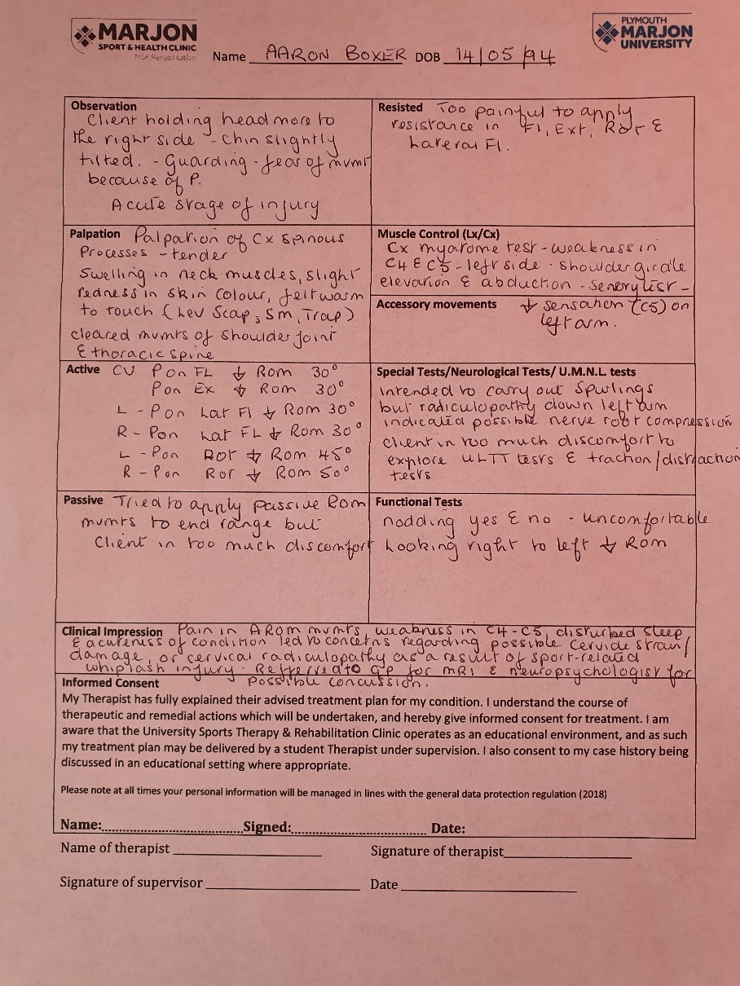
Significant and positive findings from clinical assessment

Slide 9
Differential Diagnosis
Mechanism | Subjective Ax | Objective Ax | DDX | Treatment
Punch to the head during competitive boxing bout | ↑ Neck pain and headaches after boxing match Disturbed sleep Feeling tired Ringing in ears Dizziness Sore shoulders, upper back and arms Tingling down left arm EMS of neck | Head tilted slightly to the right – guarding of left side of neck? Palpation: Tenderness over spinous processes. Tension in muscles around the neck. Red in colour & feel warm UFT, Lev Scap & SM ↓AROM in Flex, Ext, Rotation, Lateral Flex Neurological tests: Myotome test - weakness in resisted shoulder girdle elevation (C4) & abduction (C5) Sensory test - ↓ reduced sensation (C5) on left arm. PROM & Resisted ROM not tested – too painful | WAD grade III – MSK & Neurological signs WAD grade IV – Cervical spine # or dislocation Soft CX disc lesions Sports-related concussion | Refer to GP for MRI Refer to Neuro-psychologist

Slide 10
Conclusion
In this case, during the SA and OA there were a number of red flags that gave cause for concern:
Disturbed sleep
Acute onset of headache and dizziness
Increase in the severity of pain
Neurological signs down the left arm
The above signs could indicate cervical arterial, vertebral or ligament damage. There were also concerns regarding SRC.
Management of the client was conservative and the assessment was limited because of the high intensity of pain and irritability of the condition which was in the acute phase. The findings from the assessment lead to the conclusion that the client should be referred to a GP for MRI scan and also to a neuropsychologist. The client should also be assessed for SRC.
A multimodal treatment programme comprising of motion, stretching and strengthening exercises and manual therapy can be put in place after the client has been cleared of any cervical damage or received medical treatment.

Slide 11
References
Echemendia, R. J., Meeuwisse, W., McCrory, P., Davis, G. A., Putukian, M., Leddy, J., … Herring, S. (2017). The Sport Concussion Assessment Tool 5th Edition (SCAT5): Background and rationale. British Journal of Sports Medicine, 51(11), 848–850.
Elkin, B. S., Elliott, J. M., & Siegmund, G. P. (2016). Whiplash injury or concussion? A possible biomechanical explanation for concussion symptoms in some individuals following a rear-end collision. Journal of Orthopaedic and Sports Physical Therapy, 46(10), 874–885.
Loosemore, M., Lightfoot, J., Palmer-Green, D., Gatt, I., Bilzon, J., & Beardsley, C. (2015). Boxing injury epidemiology in the Great Britain team: A 5-year surveillance study of medically diagnosed injury incidence and outcome. British Journal of Sports Medicine, 49(17), 1100–1107.
McCrory, P., Meeuwisse, W., Dvořák, J., Aubry, M., Bailes, J., Broglio, S., … Vos, P. E. (2017). Consensus statement on concussion in sport—the 5th international conference on concussion in sport held in Berlin, October 2016. British Journal of Sports Medicine, 51(11), 838–847.
Neidecker, J., Sethi, N. K., Taylor, R., Monsell, R., Muzzi, D., Spizler, B., … Inalsingh, C. (2019). Concussion management in combat sports: Consensus statement from the Association of Ringside Physicians. British Journal of Sports Medicine, 53(6), 328–333.
Spitzer, W.O., Skovron, M.L., Salmi, L.R., Cassidy, J.D., Duranceau J. & Suissa, S. (1995). Scientific monograph of the Quebec Task Force on whiplash-associated disorders: redefining ‘‘whiplash” and its management. In Brukner, P. and Khan, K. (2012). Brukner and Khan’s Clinical Sports Medicine. Australia: McGraw-Hill Education

