Slide 1
Rationale
These 3 lesson plans have been created to help key stage 1 children think about their emotions and the act of bullying, along with how these can affect those around them.
To start with there is a 20 minute lesson to discuss emotions, what they are and how use of language can determine how a person feels. The purpose is to get children thinking about the type of dialogue they use. This is then demonstrated using 2 apples to show how unkind words and actions can have an affect on someone inside.
The two follow on lessons use a book called ‘ Giraffe is left out’. This is a story about bullying and how it makes a person feel. The aim of these lessons is to get children to think about their actions and how these can have the ability to dent a persons confidence and make them feel negative emotions. The aim of the lessons is to get children to explore scenarios that can have a detrimental impact on someone's mental health and well-being, whilst helping them to explore and understand ways in which they can resolve these for the better and promote kindness.
Book Reference
Graves, S., and Dunton, T. (2016). Giraffe is left out. London, England: The Watts Publishing Group.

Slide 2
LESSON TITLE Lets talk about emotions Lesson number one 20 mins
Wellbeing Area/ concept | Activity | Outcome | Materials/Equipment needed
Eg BULLYING Discussing how it feels to be treated badly by people saying unkind things to us. | Using two apples to demonstrate how they both look the same on the outside. Pass 1 apple around say kind things, pass the other around and say unkind things. Check they still look the same on the outside. Out of view swap one apple for a pre bruised apple. Cut them both in half and see what they look like in the middle. (pre bruised will be brown) | Just because you can’t see the effect of nasty words it doesn’t mean they don’t upset and hurt you on the inside. Think before you say anything that upsets others. Discuss what you can do if someone is being horrible to you. | 3 apples (look the same) 1 chopping board 1 knife Word mat
KEY VOCABULARY | Emotions, Feelings, embarrassed, confused, upset, sad

Slide 3
Key Stage 1 resource
Emotions

Slide 4
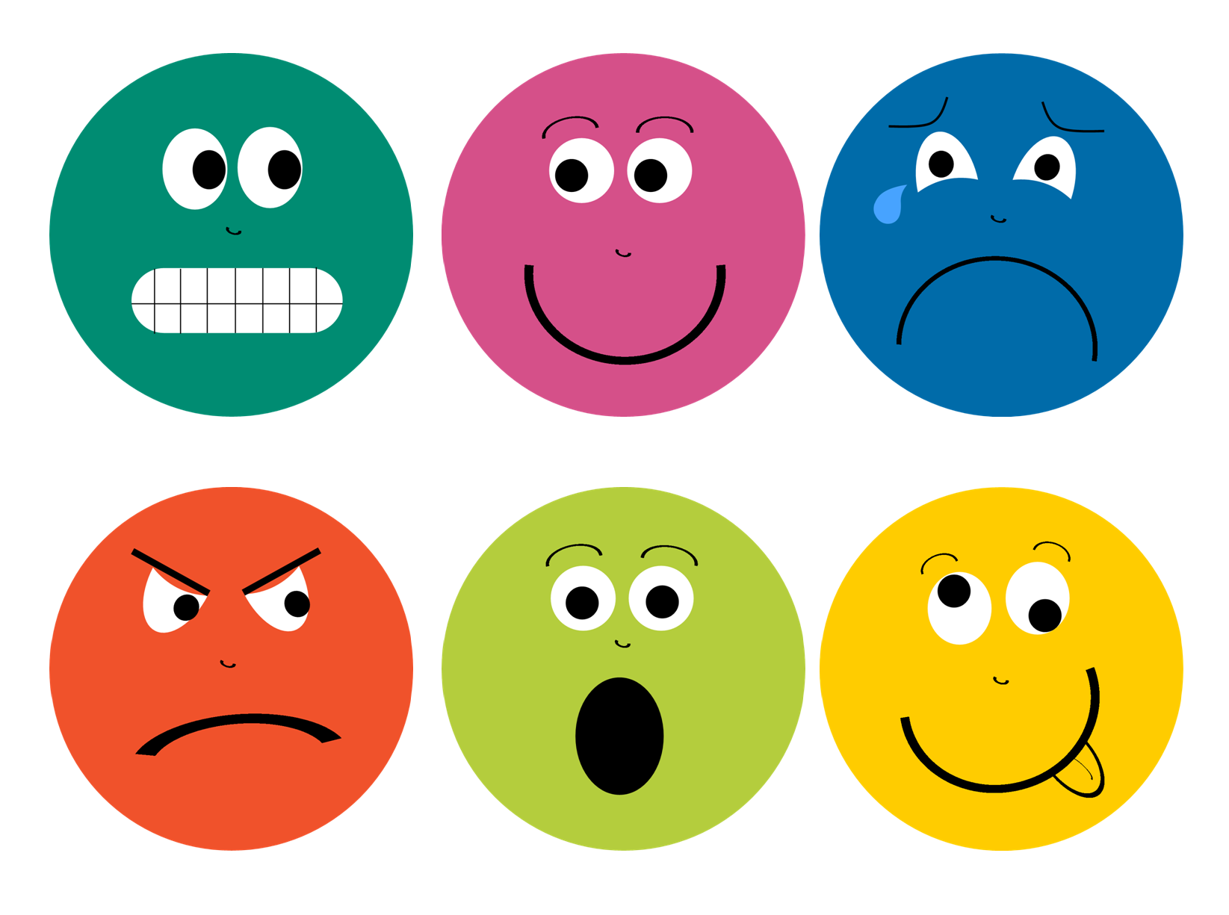
Lets talk about EMOTIONS
What are emotions?

Slide 5
An emotion is how you are feeling.
Can you name any?
Happy
Sad
Scared
Worried
Jealous
Frustrated
How do you know what someone's emotion is if they do not tell you?
From the way they speak
How they are standing
What they say
How they act

Slide 6
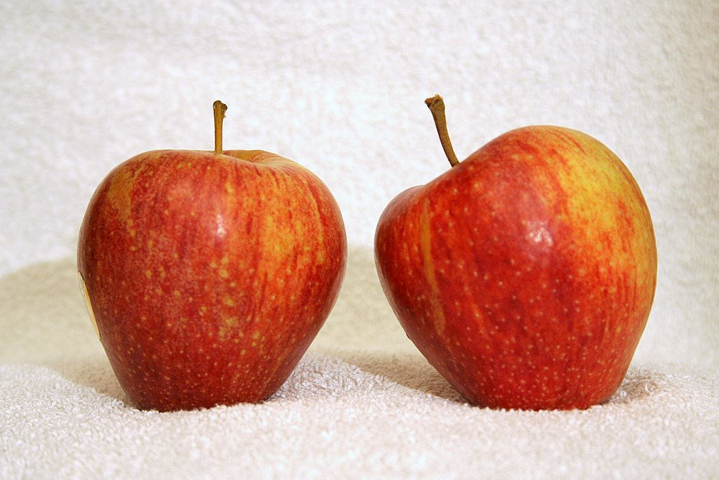
Look at these 2 apples – they are the same

Slide 7
Say kind things to this apple
You are funny
I like you
Would you like to play
Say horrible things to this apple
Your hair looks silly
I hate you
You are not very good at running

Slide 8
Do the apples still look the same?

Slide 9
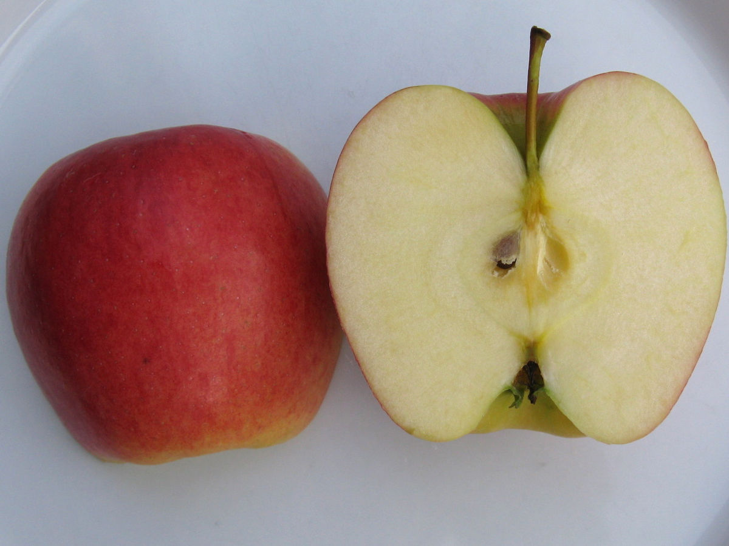
This apple had nice things said to it, the inside looks good.
This apple had horrible things said to it, the inside looks bad.

Slide 10
Horrible words and unkind behaviour can make us feel upset on the inside, even though we might not show it on the outside.
We need to make sure that we are kind to the people around us so that they are not sad on the inside.

Slide 11
LESSON TITLE Listening and writing a story Lesson number two – 50 mins
Wellbeing Area/ concept | Activity | Outcome | Materials/Equipment needed
BULLYING Discussing how it feels to be left out at school | Listening to the story Giraffe is left out Picking up on key areas of the book and talking about the story Writing our own story based on a similar scenario | The children will think about how it feels to be left out Thinking and talking about how we treat other people around us Build an awareness to our own feelings and those of other people Use writing skills to develop our own stories about feelings and emotions Create awareness to mental health and well-being. | Giraffe is left out book Paper Pencils Word mats
KEY VOCABULARY | Upset, thank you, sad, together, friend, feelings

Slide 12
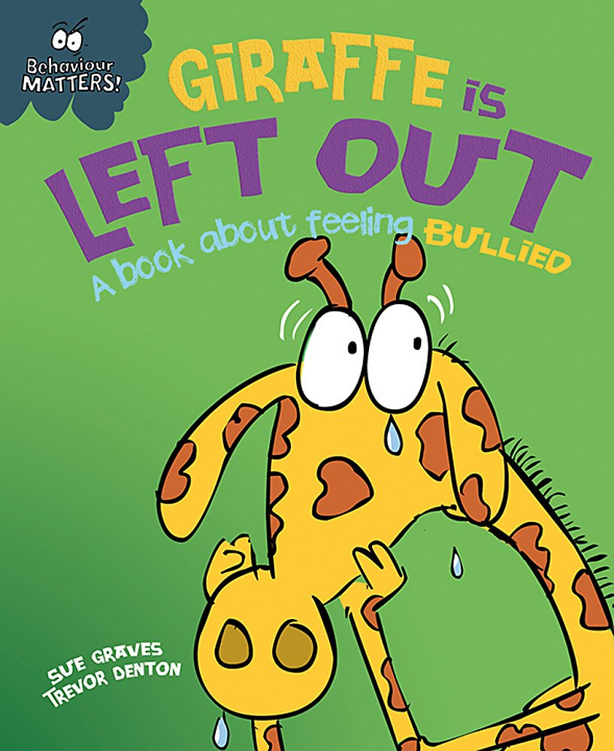
Lets Read a story about bullying
Story writing to talk about how we feel when we are not included.
First we will read the story.

Slide 13
‘At playtime all the animals played football. Monkey said Leopard could play too. Giraffe got cross. He said Leopard COULD NOT PLAY. He told Leopard to GO AWAY.
Leopard was SAD, he did not like being LEFT OUT. Little Lion said giraffe was being VERY UNKIND.’
How do you think Leopard felt?
Why do you think Giraffe did this?
What could have happened?

Slide 14
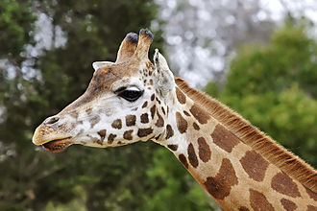
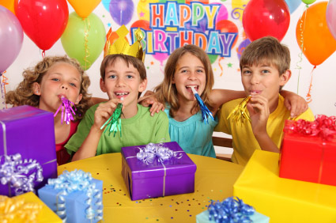
‘On Tuesday, Leopard came to school, he was very excited. He said it was his birthday on Saturday. He said EVERYONE could come to his party. Leopard handed out all the invitations. But he did not give one to Giraffe. Giraffe was UPSET. He did not like being LEFT OUT.’

Slide 15
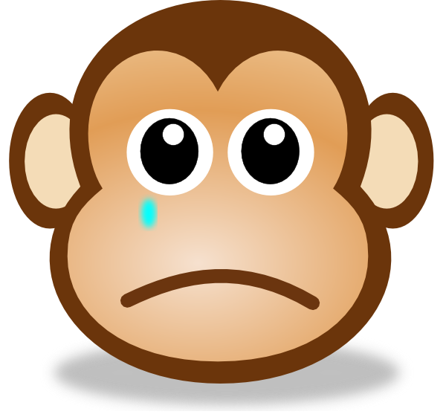
Why was giraffe UPSET?
How do you think he felt?
Why do you think Leopard did not invite him?
Can you think of any other words to describe being UPSET?

Slide 16
‘Leopard said his party would be GOOD FUN. He described what they were going to do at the party. Play games together, eat cake. Giraffe felt REALLY MISERABLE. He wished he could go. Monkey said he had been UNKIND to Leopard. Little Lion said if he HAD BEEN KINDER he might not have been LEFT OUT.’
What does MISERABLE mean?
What how can you make someone feel MISERABLE?
Can you think of ways to be KIND?

Slide 17
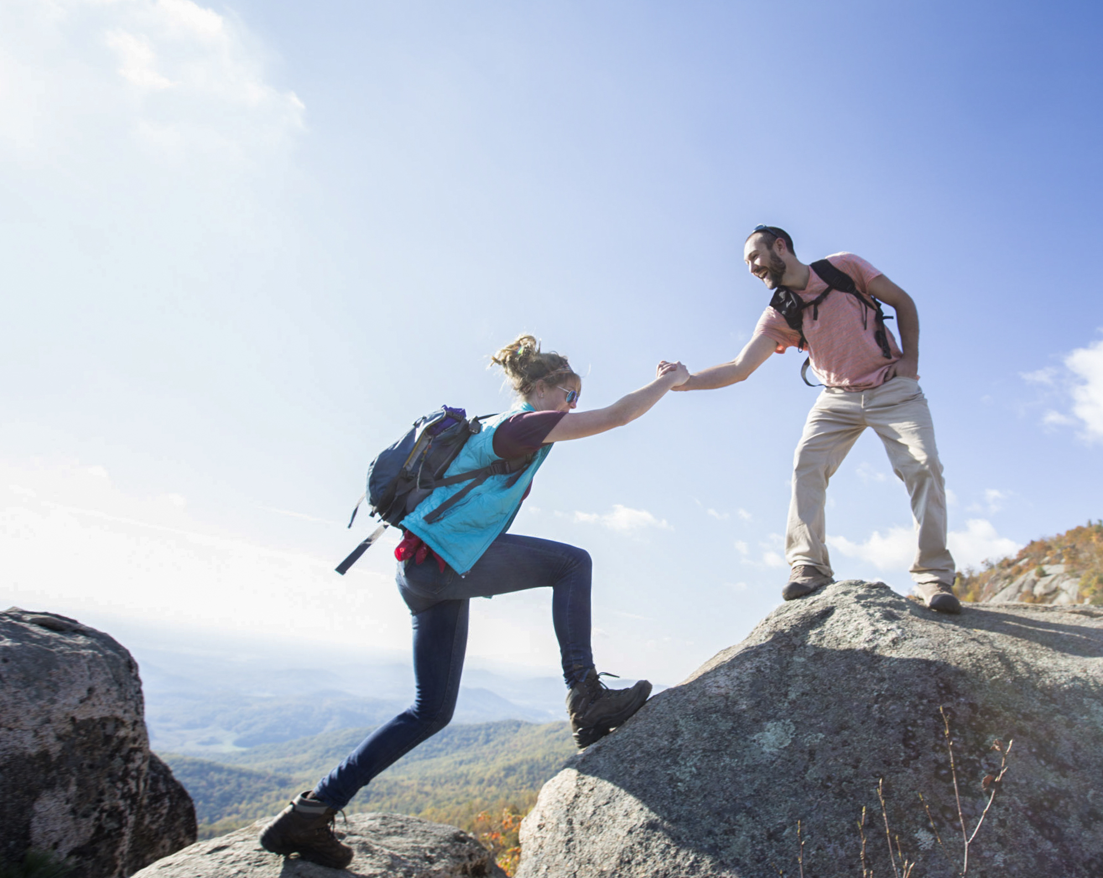
‘That afternoon the teacher said that Giraffe and Leopard had to WORK TOGETHER in a pair. Giraffe said he did not want to because Leopard was NOT HIS FRIEND.
The teacher did not listen so they had to do it. Giraffe needed HELP, Leopard showed him what to do, Giraffe WAS PLEASED. Then Giraffe helped Leopard with something. Leopard said THANK YOU.’
Why did Giraffe upset Leopard? What did he say?
How did they resolve their differences?

Slide 18
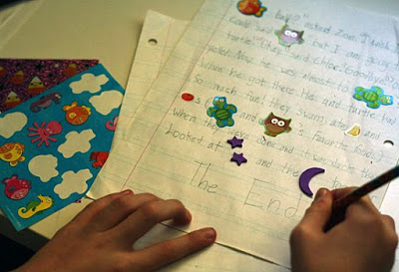
Can you come up with some ideas for a different story based on what you have just heard?
Think about other scenarios where someone gets left out.
Not allowed to join in a game
Not invited to a sleepover
Can not sit next to some one in class
Do you have an idea of how a person would feel?
Angry
Left out
Sad
Lonely
Crying

Slide 19
LESSON TITLE Acting out stories, discussing what we’ve learnt and creating posters Lesson number three – 50 mins
Wellbeing Area/ concept | Activity | Outcome | Materials/Equipment needed
Eg BULLYING Learning what we can do if we feel upset by being bullied | Re read the story Acting out the stories written in lesson 2 Discussing how we feel if we are being bullied and who we can talk to. If there is time creating posters to go up in the classroom to give kind messages. | The children will be able to think about what they can do if they feel bullied and discuss who they can talk to. Build on previous ideas and discussions to understand our own feelings and behaviour and how these can impact on other peoples lives. Share our ideas with others | Stories from lesson 2 Paper and pens Word mats Giraffe is left out book

Slide 20
Acting out our stories.
Think about how it feels to be bullied.

Slide 21
In the last lesson we created stories based on the book
‘Giraffe is left out’

Slide 22
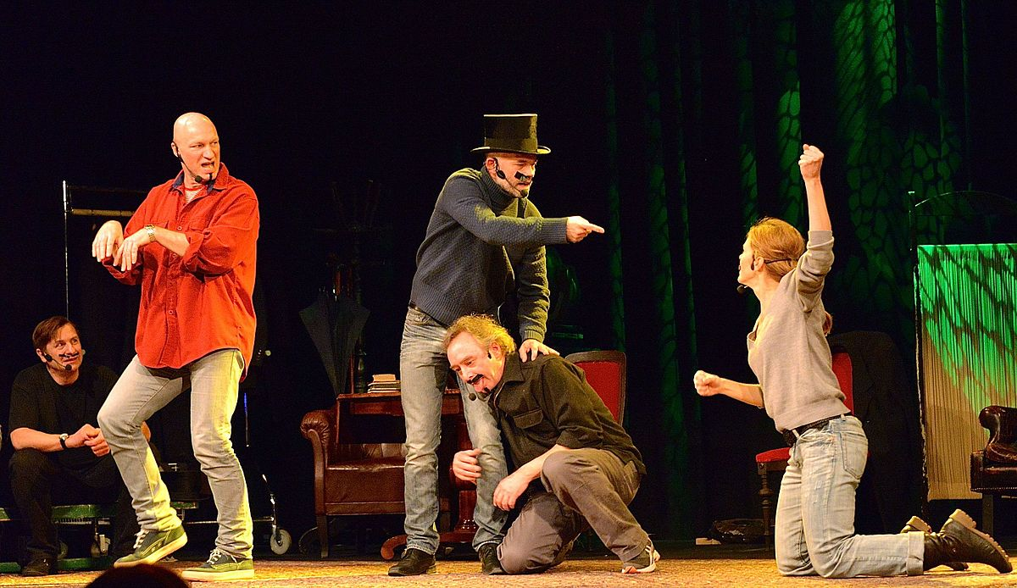
Now we’ve reread the story lets read out some of the stories we wrote.
Then we will get into groups and have a go at acting out each others stories.

Slide 23
What did we think about each others stories?
Did it make you think about how it feels to be bullied and left out?
What can you do to make everyone feel included?

Slide 24
What can we say that is kind, encouraging and includes everyone?
Happy
We can share
I like you!
You are my friend
Do you need any help?
Would you like to sit next to me?
I think you are really good at football
If some on upsets you, or you feel sad who can you tell?
Talk to a teacher or Teaching Assistant
Talk to someone at home
Tell a friend

