Slide 1
Food moving through the system: A simple guide from a
Warehouse Manager

Slide 2
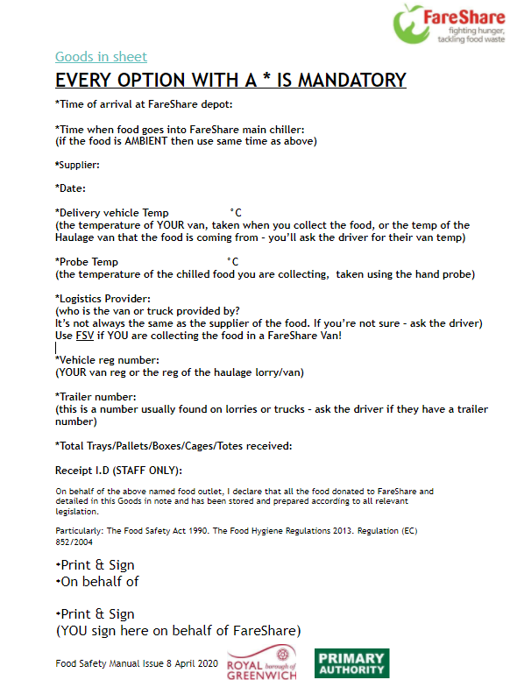
Goods In
For all food that arrives at FareShare we complete a goods in sheet
On our goods in sheets, every piece of information we collect is a legal requirement
We have to keep our sheets for at least 2 years and present them at audit

Slide 3
Goods In
Check with your local food safety authority what details are required
Make sure your staff / volunteers understand why this is important and put processes in place to check paperwork. This provides opportunities to retrain staff and volunteers on the spot

Slide 4
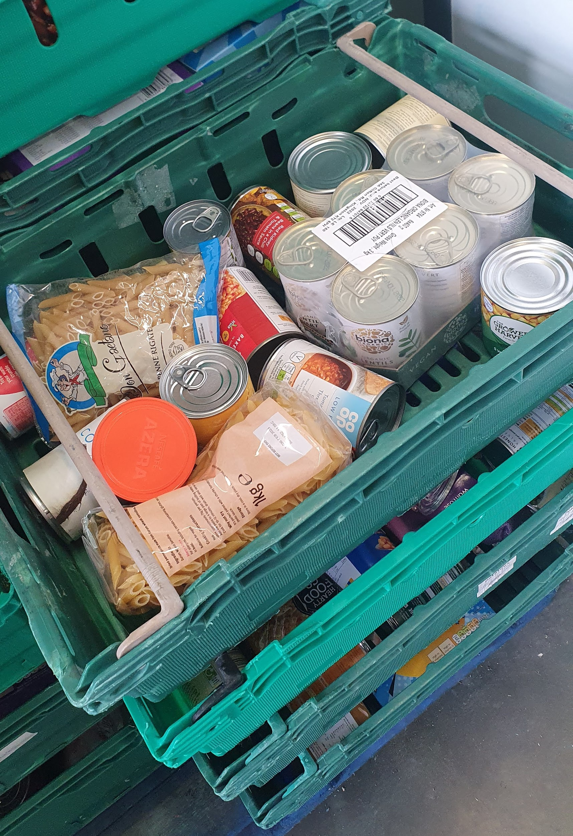
Sorting food
Often the food we receive comes in as a mix of different products
We need to:
Remove anything that is out of date or unsuitable
Separate chilled from ambient food
Group the same or similar types of food together for storage
Count the number of boxes, cases or packets
Record the weight and date
Input all of this information into the Stock Management System
Sorting food is generally a low skill task, requiring good reading skills and to understand simple instructions
Most volunteers enjoy the process. It is social and repetitive

Slide 5
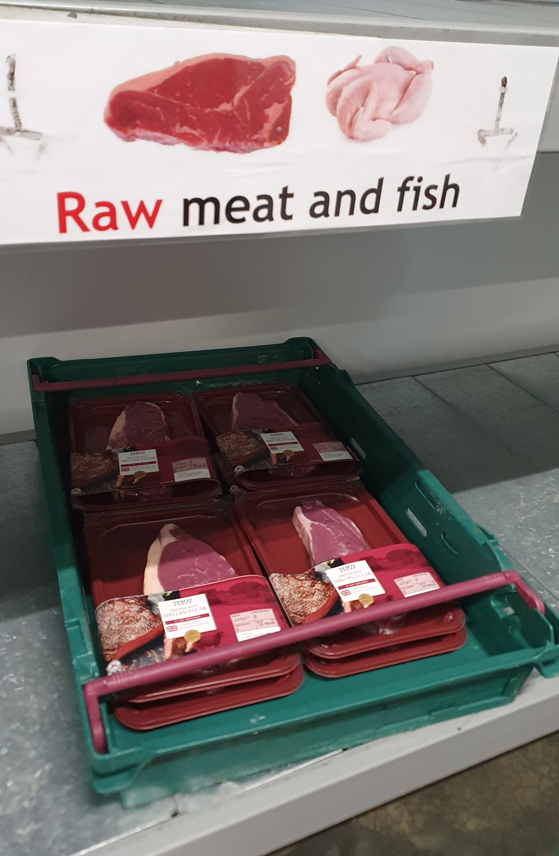
Storing food
We have facilities for ambient food and for chilled food
Ambient food is stored in the warehouse
Chilled food in the fridge is separated into different areas based on Food Safety rules:
Raw meat (always on the bottom shelf)
Cooked meat
Dairy (including vegetarian food)
Fruit and vegetables
This ‘zoning’ of areas also helps the picking team to locate individual items quickly and effectively
We use a warehouse Zoning System which is programmed into the Stock Management software. We digitally save items in the correct zone, and the item is physically put there for locating later by the pickers. Example: Zone 01=Raw Meat

Slide 6
Allocating food
Not all charities can receive all types of food (Food Safety Assessment/premises, prove before we deliver)
Different charities receive different quantities of food depending on how many people they feed, storage facilities & membership fee
All of this information is entered and stored in the Member Profile in the Stock Management System. When a new charity joins us - this information is entered
We look at the Member Profile when we allocate the food to each charity

Slide 7
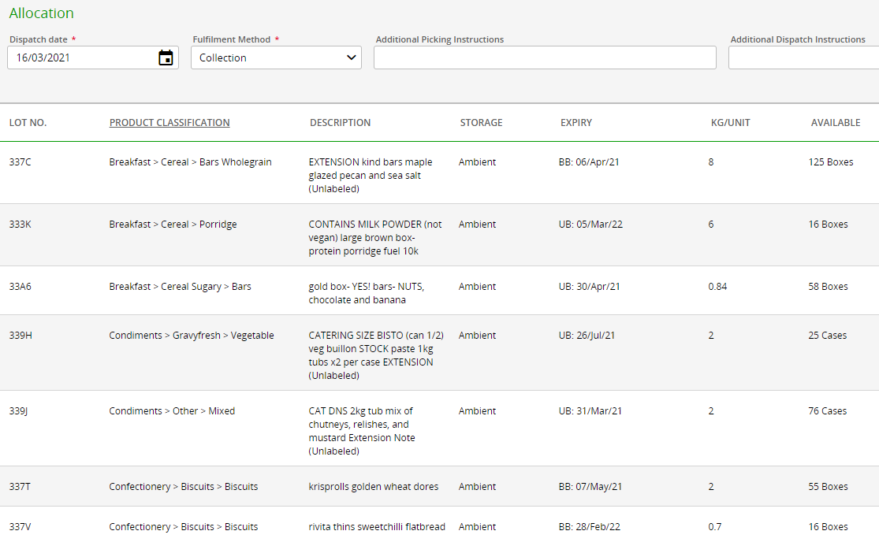
Allocating food
7 ‘categories’ to select - never individual items
Other main factor for allocating = use by date: send out short dated food faster
Once an allocation is made, it is printed as a Dispatch Note, ready for picking

Slide 8
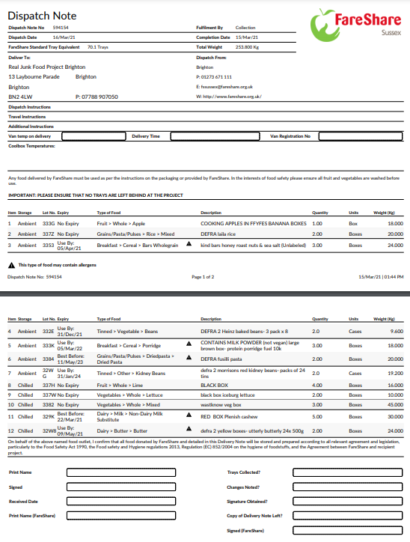
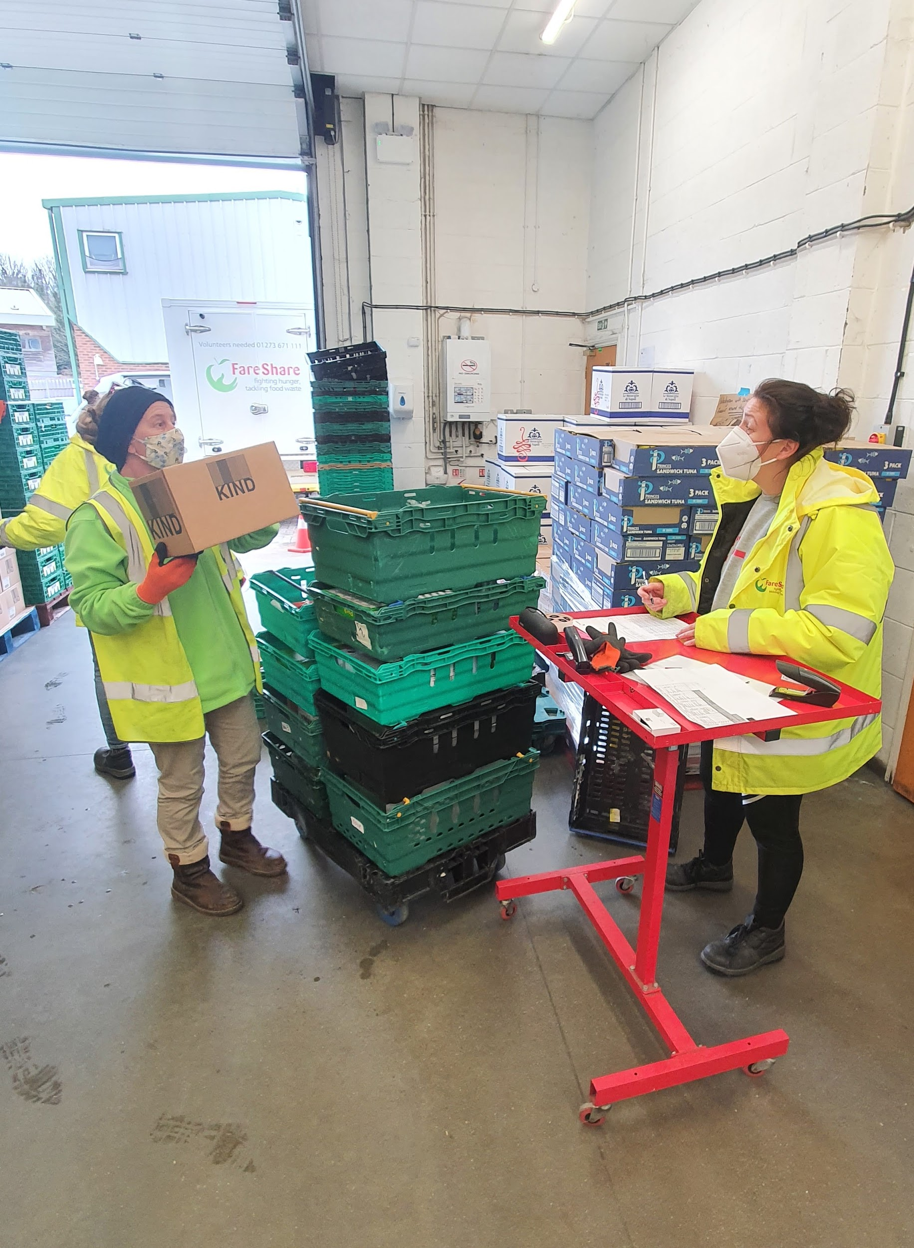
Picking food
Volunteers will be given the completed Dispatch Note with the list of every item the charity is expecting. We have created this list ourselves during Allocating
A ‘caller’ will stand and read the list and other volunteers will go around the warehouse and pick the items
This requires accuracy, attention to detail and good communication skills
It is important that food is picked correctly because it affects the stock inventory and also the charity will receive the wrong food or missing food

Slide 9
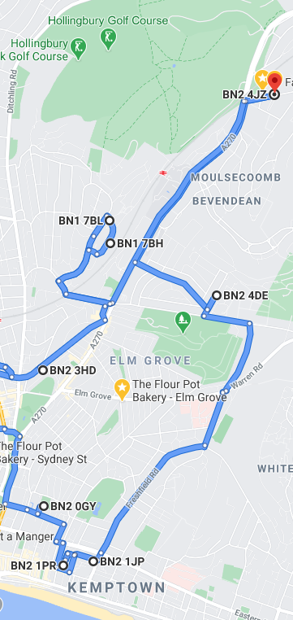
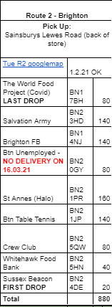
Delivery Routes
Routes planned based on the efficiency of a journey, the maximum weight a van can carry, the locations or general areas a van will travel in on that day.
The route is updated whenever a charity signs up.
Sometimes we have to refuse a charity because we have no capacity, or we can’t justify the direction or distance
We use Google Maps and spreadsheets to manage this manually but you can also use specific route mapping software if you have the funding - it takes a lot of work and gets complicated!

Slide 10
Delivering food
When delivering food, our drivers will have the dispatch note for each delivery in a Drivers folder
This document is also a small agreement or contract, and must be signed by both parties on delivery.
We double check every sheet when drivers return before storing the paperwork ready for annual audit. This is also an opportunity to re-train and understand if the process works for the people, on the spot

Slide 11
People
Challenge: Working with diverse groups of people in a busy operational environment
Everyone must be safe and feel rewarded for their work
Health and Safety and Food Safety laws MUST be adhered to, without negotiation
When is a process not working?
Don’t blame the people, blame the project
looking again at the bigger picture, take it apart and create it again
Create it in a new way until the people understand it
Of course you cannot create a process for everyone. Some people will have to learn it.

Slide 12
People
Warehouse work and food distribution are very detail oriented environments.
Staff and volunteers MUST be shown the importance of detail in every part of the process, and be reminded when you see details being missed
Lead by example in creating a culture of attention to detail and your work will be more efficient, accurate, safer, cleaner and faster
Different people understand processes in different ways. I use text, images, verbal communication, physical training and trust to build a strong team
I encourage peer-to-peer training and a culture of asking questions. I always make time to train - as a priority
Always explain the ‘WHY’ - people feel closer to the process if they can see the bigger picture and understand the reason behind a task
When people are supported by a strong foundation of processes that make sense, they are able to work freely and efficiently. Managers are able to delegate more efficiently because the ‘process’ is universal and supports any person who is learning it. Process is usually supported by paperwork or documents with images

