Slide 1
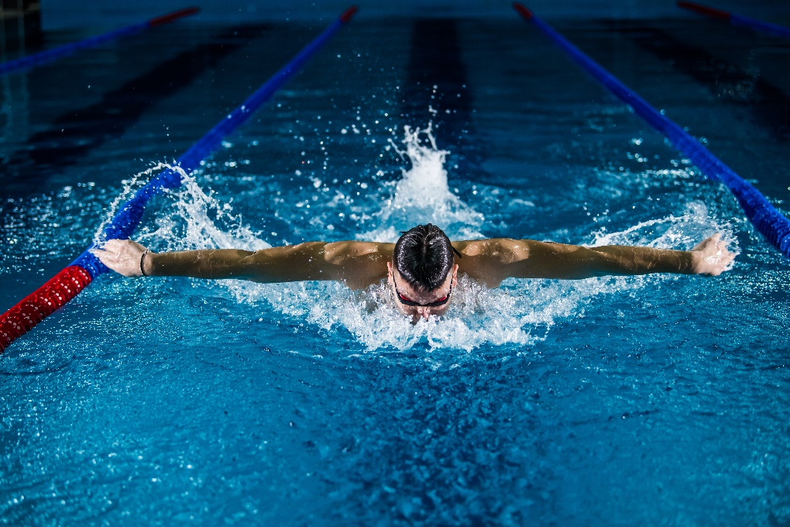
Shoulder External Impingement
Photo by Gentrit Sylejmani on Unsplash
By Karen & Rebecca

Slide 2
What is it?
Affects part of the shoulder know as the subacromial space (commonly referred to as subacromial impingement).
‘It is the mechanical encroachment of the soft tissue (bursa, rotator cuff tendons) in the subacromial space between the humeral head and the acromial arch. This encroachment takes place in the midrange of motions, often causing a ‘painful arc’ during active abduction.’ (Cools, 2017).
Subacromial Impingement is not a pathology but a clinical impression and can result in other shoulder pathologies e.g. Scapula Dykinesis, RC instability
Prevalence
Prevalent in swimmers, basketball players and tennis players (Efstratiadis et al., 2017). Also affects construction workers, painter & decorators.
Most at risk in individuals with previous dislocation injuries, >40 yrs and above (can present in younger patients), individuals with unusually shaped acromion (Garving, Jakob, Bauer, Nadjar, & Brunner, 2017).

Slide 3
Mechanism of injury: Overuse injury
Causes of external impingement can be divided into 2 categories:
Primary – Most common cause and accounts for 40% of shoulder pain
Subacromial bone spur
Subacromial abnormality (hooked shaped acromion), congenital abnormality (OS Acromiale or osteophyte formation)
Swelling in subacromial space (subacromial bursa),
Bursal hypertrophy.
Secondary
Improper Rotator Cuff outlet size – due to inadequate muscular stabilisation of the scapula
Rotator cuff weakness, instability.
Affects younger throwing athletes <35 years. Fairly uncommon compared to primary external impingement.

Slide 4
Subjective Assessment:
Establish onset: acute, subacute, chronic
Pain: exact site of pain, severity, affects on ADL & sporting activities, aggravating/easing factors, does pain travel or radiate
Red flag conditions/Contraindications - THREADS.
Past/present injuries & clarify exact treatments for conditions.
Look for predisposing problems – training load, pyscho/social issues.
Patient may c/o of painful arc of motion, pain when lying on their side, pain worse at night, minor but constant pain in arm. Pain travels from anterior shoulder to lateral side of arm, shoulder weakness. Catching or locking.

Slide 5
Objective Assessment:
Observe patient front, back & side. Look for asymmetry of bony points, muscle bulk, scapular motion, shoulder height, spinal curves, head position and general posture, AC and SC protuberances.
Palpate bony points, muscles, tendons and ligaments. There may be tenderness in the RC tendon region.
Clear joints above & below Cervical spine & elbow – active mvmts with o/p checking for pain
In movements of flexion, extension, abduction, adduction, internal rotation, external rotation, elevation, depression, protraction & retraction:
Assess
Active ROM checking for range & pain – for external impingement looking for ↑ pain & ↓ROM in arcs of flexion & abduction
Passive ROM with o/p checking for range & end feel
Resisted ROM checking for muscle strength & pain. Looking for weakness of RC muscles, early fatigue and instability. Pain without weakness could be tendinopathy, weakness could indicate muscle tears.
Carry out special tests based upon findings of the subjective & objective assessment

Slide 6
Differential Diagnosis
Jobe +
Neer + ant
Hawkins +
Apprehension +
(Pain) ant
Impingement Symptoms
Jobe -
Neer + post
Hawkins -
Apprehension +
(Pain) post
External Subacromial Impingement
Internal Subacromial Impingement
Relocation -
Relocation +
Release + (pain)
Relocation +
Release + (pain)
Primary Impingement
Secondary Impingement
Laxity tests +
Apprehension + (appr)
Relocation + (appr)
O’Brien +
Speed’s +
Biceps load II +
IR ROM +
SAT +
STR +
Full Can +
Rotator Cuff Pathology
Scapular Dyskinesis
Instability
Biceps SLAP Pathology
GIRD
Cools, 2017. Cools, A. M. (2017). Shoulder Pain. In B. Clarson, J. Cook, A. Cools, K. Crossley, M. Hutchinson, P. McCrory, & R. Bahr (Eds.), Brukner and Khan’s Clinical Sports Medicine—Volume 1 (5th ed., pp. 377–438). Sydney, Australia: McGraw Hill Education (Australia)

Slide 7
Treatment
Acute phase: reduce pain and inflammation using cryotherapy, thermotherapy modalities and STM. Normalise ROM, delay muscle atrophy. Focus on RC and scapular retractors. Functional loading is limited until full ROM is restored
Intermediate phase: Strengthening exercises progress into isotonic training of the shoulder girdle and core. Improve flexibility with intensive stretching exercises particularly of posterior shoulder structures
Advanced strengthening phase: strength training focussing on enhancing power and endurance e.g. plyometrics, endurance drills and controlled sport-specific exercises initiated.
Return to play phase: athlete progressively increases sport-specific exercise programme, continues with flexibility stretching drills and prepare to return to competitive sport

Slide 8
References
Cools, A. M. (2017). Shoulder Pain. In B. Clarson, J. Cook, A. Cools, K. Crossley, M. Hutchinson, P. McCrory, & R. Bahr (Eds.), Brukner and Khan’s Clinical Sports Medicine—Volume 1 (5th ed., pp. 377–438). Sydney, Australia: McGraw Hill Education (Australia).
Efstratiadis, Α., Marangos, S., Kasapakis, E., Georgiadou, P., Ploutarxou, G., Stelicos, G., … Stasinopoulos, D. (2017). The subacromial impingement syndrome of the shoulder: The role of physiotherapist in the evaluation and treatment of the syndrome. Journal Biology of Exercise, 13(1), 15–32.
Garving, C., Jakob, S., Bauer, I., Nadjar, R., & Brunner, U. H. (2017). Impingement syndrome of the shoulder. Deutsches Arzteblatt International, 114(45), 765–776.

