Slide 1
Facet joint dysfunction
Special consideration of women

Slide 2
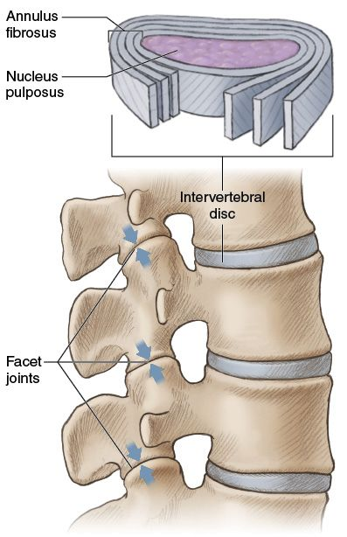
What is a Facet Joint?
The facet joints, are a set of synovial, plane joints between the articular processes of two adjacent vertebrae.
The facet joints are involved in all movements in the spine such as;
Flexion
Extension
Rotation
Lateral flexion

Slide 3
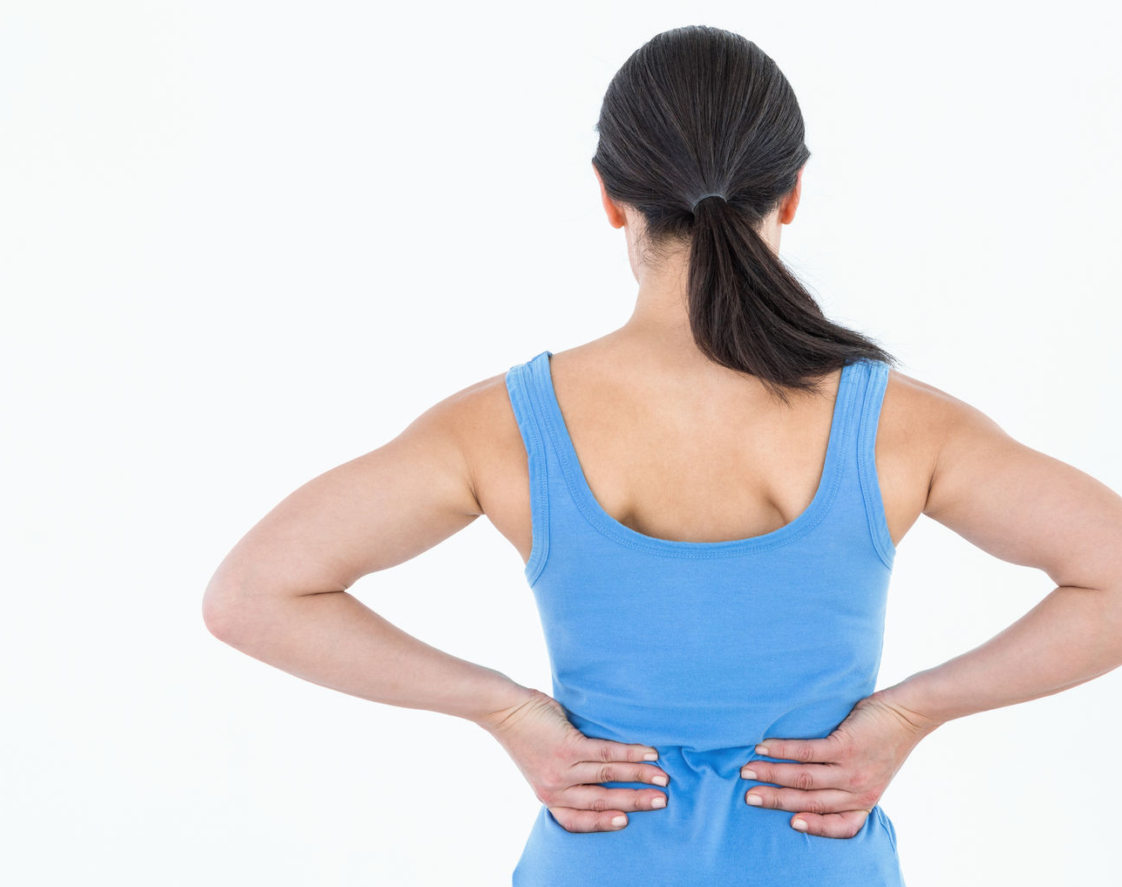
Causes of pain
Degenerative disorders
Traumatic injuries

Slide 4
Degenerative disorders
Osteoarthritis- damage to the cartilage, reduction of synovial fluids, generation of osteophytes.
Spondylolisthesis- arthritic facet joints may crumble and allow the vertebra to slide out and become displaced.
Synovial facet joint cyst- leads to pressure build up that can compress structures.
In the upper lumbar spine, the greatest amount of joint displacement and strain is associated with lateral-flexion or side-bending in the first three pairs of facet joints (L1-L2; L2-L3; L3-L4). The two lowest levels(L4-L5; L5-S1) experience the greatest strain during forward flexion.

Slide 5
Traumatic injuries
Acute facet injury
Repetitive trauma that leads to a #

Slide 6
Treatment for facet joint dysfunction.
Heat therapy- relaxes surrounding muscles, Vasodilatation. Best used in morning to reduce any AM stiffness.
Cold therapy- Used best with painful flair ups such as post physical activity.
Supporting lumbar curve- maintaining neutral alignment of the spine can reduce the risk of onset of pain. This is as good posture takes any excess pain off the facet joints.
Physical therapy- useful in improving and maintaining the stability of the lower back to again reduce the load on the facet joints by increasing muscular stability and strength
TENS- the reduction of pain by supplementing the release of endorphins.

Slide 7
Objective markers regarding facet joint rehab
ROM- comparing ROM in the spine at the beginning and end of sessions is important to see if there is an increase in ROM and also to see if there is an increase/decrease in onset and severity of Px
Quality of sleep- Making note of the amount a patient is sleeping between each session is important. If quality of sleep improves then it is a good indicator that the treatment is working.
Functional movement cues- Glute firing, hamstring tension and pelvic tilt are all factors that can affect pain onset in the facet joint. Noting improvements and differences can aid a clinician on scoping how well treatment is going.

Slide 8
Populations- Gender
Women are more likely than men to develop osteoarthritis. If it runs in the family then there is a much higher chance of developing the condition. Its been found that women will develop symptoms at the same age their mother did.
Hormones- Hormonal differences in women may also lead to an increased risk in developing osteoarthritis. This is as post menopause oestrogen levels decrease meaning they lose the hormone that is involved with protecting cartilage.

Slide 9
Differential treatment with arthritis in men and women?
Men are twice as likely to reg a recommendation in joint replacements and surgery compared to women.
This is as men are ‘more active’ than women. As doctors usually treat arthritis more conservatively when you’re less active.
Should there be different management for arthritis depending on activity level?

Slide 10
References
DePalma, M. J., Ketchum, J. M., & Saullo, T. R. (2012). Multivariable analyses of the relationships between age, gender, and body mass index and the source of chronic low back pain. Pain Medicine, 13(4), 498-506.
Glowacki, J., Hurwitz, S., Thornhill, T. S., Kelly, M., & LeBoff, M. S. (2003). Osteoporosis and vitamin-D deficiency among postmenopausal women with osteoarthritis undergoing total hip arthroplasty. JBJS, 85(12), 2371-2377.
Gupta, A., Heng, T., Shaw, C., Li, L., & Feehan, L. (2018, May). Designing pervasive technology for physical activity self-management in arthritis patients. In Proceedings of the 12th EAI International Conference on Pervasive Computing Technologies for Healthcare (pp. 1-10).
Varlotta, G. P., Lefkowitz, T. R., Schweitzer, M., Errico, T. J., Spivak, J., Bendo, J. A., & Rybak, L. (2011). The lumbar facet joint: a review of current knowledge: part 1: anatomy, biomechanics, and grading. Skeletal radiology, 40(1), 13-23.
Kettler, A., & Wilke, H. J. (2006). Review of existing grading systems for cervical or lumbar disc and facet joint degeneration. European Spine Journal, 15(6), 705-718
Pearson, A. M., Ivancic, P. C., Ito, S., & Panjabi, M. M. (2004). Facet joint kinematics and injury mechanisms during simulated whiplash. Spine, 29(4), 390-397.

